Slide 1

INFORMATION SYSTEMS SECURITY, CONTROL AND AUDIT
Information Systems Security
THE CHANGE IN HOW PEOPLE AND BUSINESSES COMMUNICATE
Week 3

Slide 2
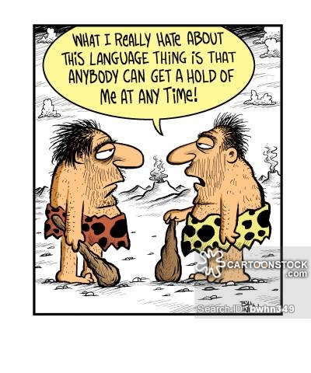
Communication

Slide 3
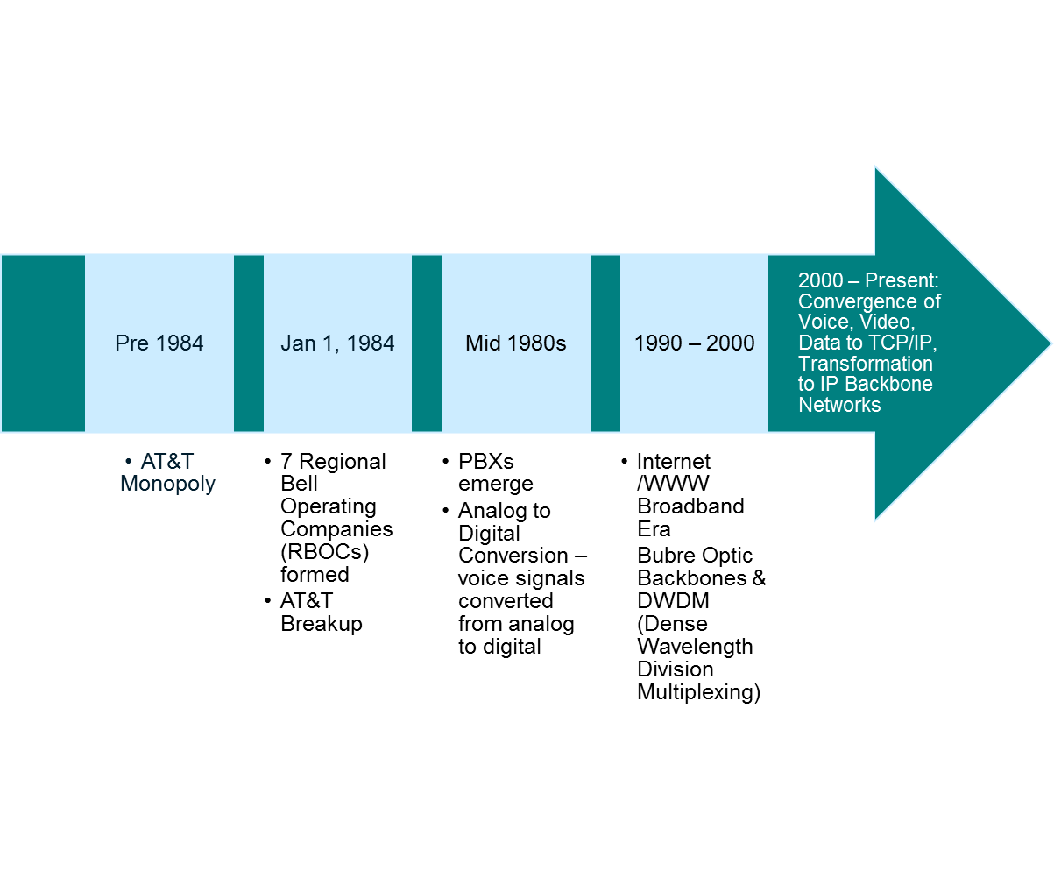
Evolution of Voice Communications
USA

Slide 4
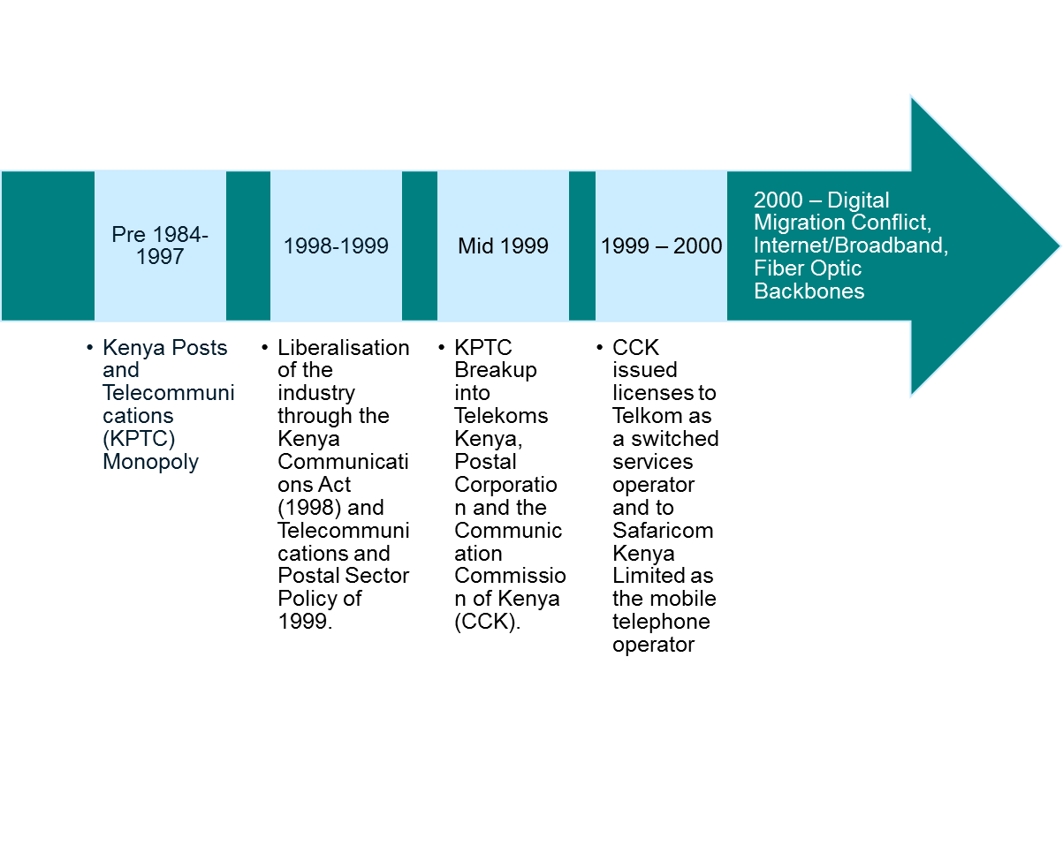
Evolution of Voice Communications
Kenya

Slide 5
Analog to Digital: Why?
Analog signals are based on a continuously generated electrical signal. Analog requires a continuous but changing +/- electrical signal.
Analog signals have a higher bit error rate. In analog it is one error for every 1,000 bits sent. In digital it is one error for ever 1,000,000 bits sent.
Analog is susceptible to electrical interference and noise
Analog speeds are slow. Can reach a maximum of 56kbps
Analog signals have limited bandwidth i.e. 0KHz to 3 KHz sound spectrum, human detectable.

Slide 6
Telephony Risks, Threats & Vulnerabilities
Digital PBX systems are vulnerable to attacks.
Attackers seek free and anonymous long-distance calling.
PBX attackers are generally organized criminals, drug dealers who want free long-distance privileges for their business.
These attackers also resell the long-distance calling.

Slide 7
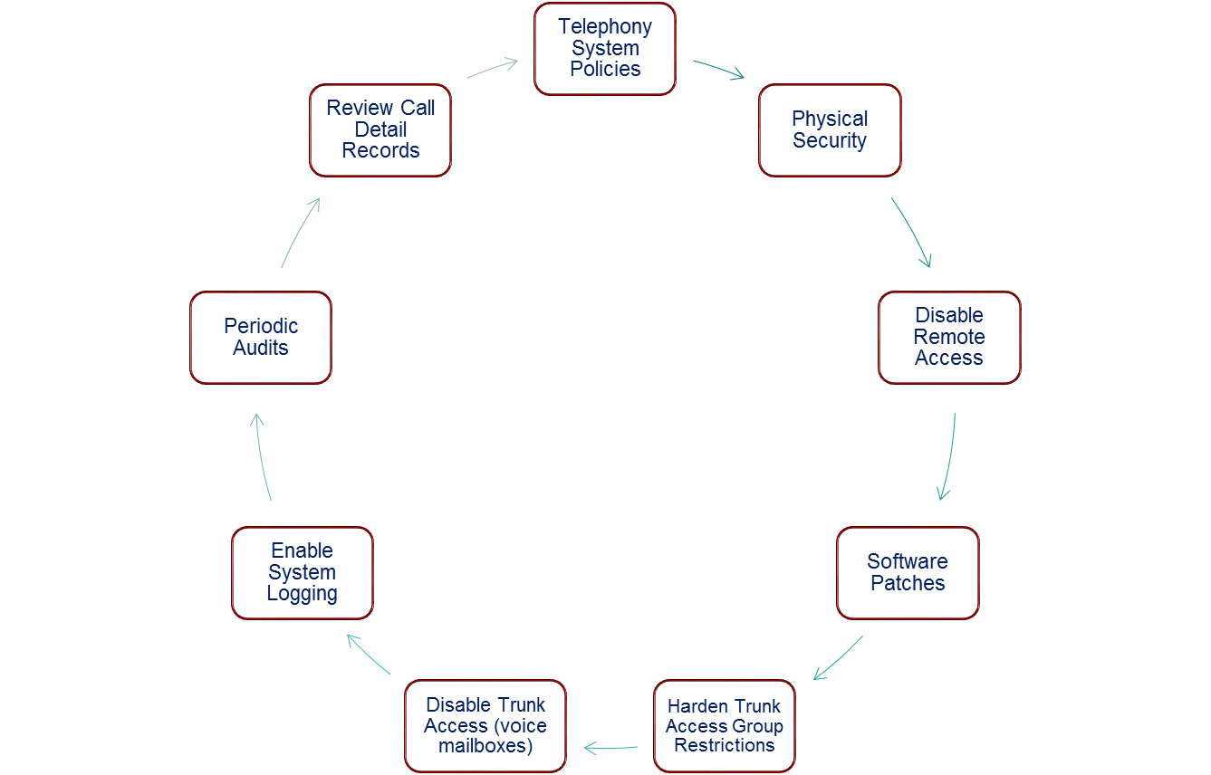
Telephony Security Best Practices

Slide 8
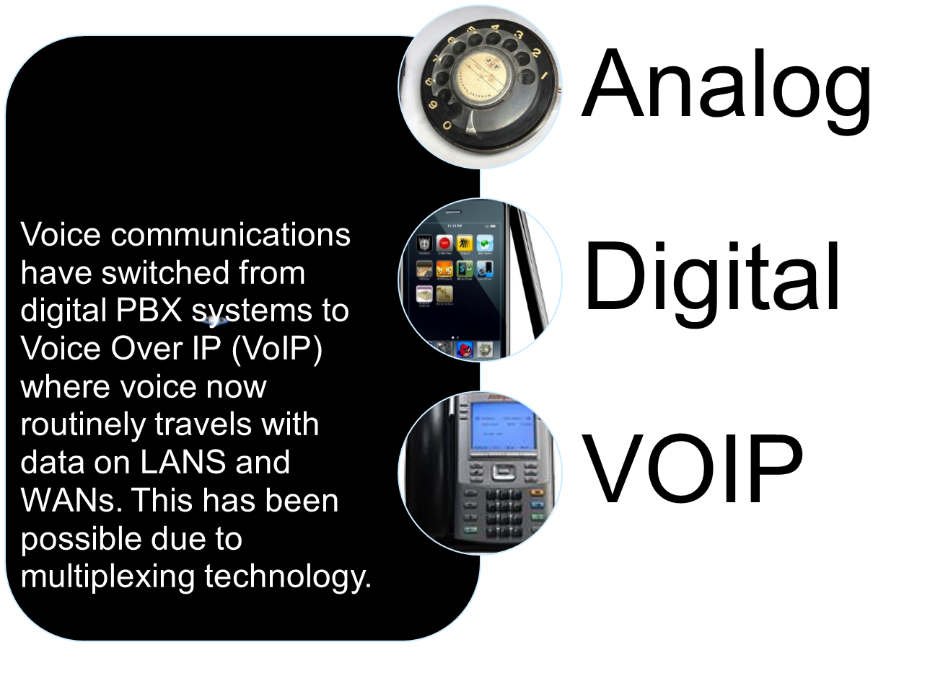

Slide 9
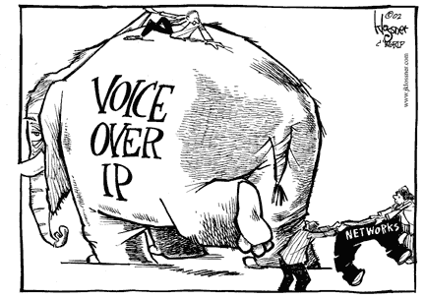
VoIP

Slide 10
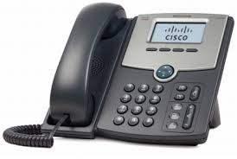
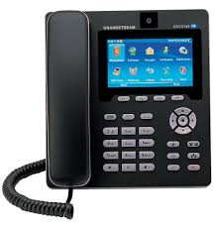
VoIP Handset

Slide 11
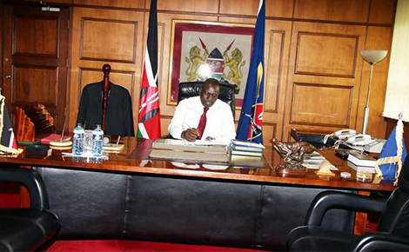

Slide 12
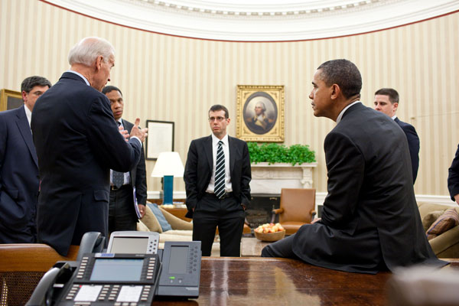

Slide 13
VoIP Risks, Threats & Vulnerabilities
Suffer from the same risks, threats and vulnerabilities of PBX digital systems and TCP/IP applications.
Potential risks are eavesdropping, attackers impersonating callers, toll fraud, brute force password attacks, DoS attacks, Server failure, Disclosure of confidential data.

Slide 14
VoIP Security Measures
Endpoint Security
- Before anyone can get a dial tone, IP phones must first logically connect to the IP network; then users must prove their identity.
- Enable and run only the minimum functions and features required on the IP phone sets and specific phone extensions.
- Require passwords or PINS before granting a dial tone for IP phones. Users must enter a valid code to dial long distance. If this is too cumbersome, users must at least be required to prove their identity when using a IP phone prior to getting a dial tone.

Slide 15
VoIP Security Measures
Physical Security
- Lock all doors to phone switch rooms, wiring closets, and cabling systems.
- Use strict physical access controls to phone switch rooms, wiring closets, and cabling distribution points.

Slide 16
VoIP Security Measures
Network Infrastructure Security
- Design and use separate VLANs for voice and data.
- Use call servers and systems on separate VLANs for proper isolation and security.
- Harden Server operating systems and application software with the latest security patch updates.
- Encrypt call server signaling if you are not able to isolate call servers on a single VLAN.

Slide 17
VoIP Security Measures
Security Operations & Administration
- Use strict password controls to call servers, VoIP systems and IP Phones.
- Use encryption (VPN, SSH, HTTPS etc) for remote access and management to call servers and VoIP systems.
- Provide backup power or a diesel generator as part of your company’s business continuity plan.
- Turn on system logging on servers. Enable call-detail recording for periodic auditing of user extensions, inbound/outbound dialing and toll calls.

Slide 18
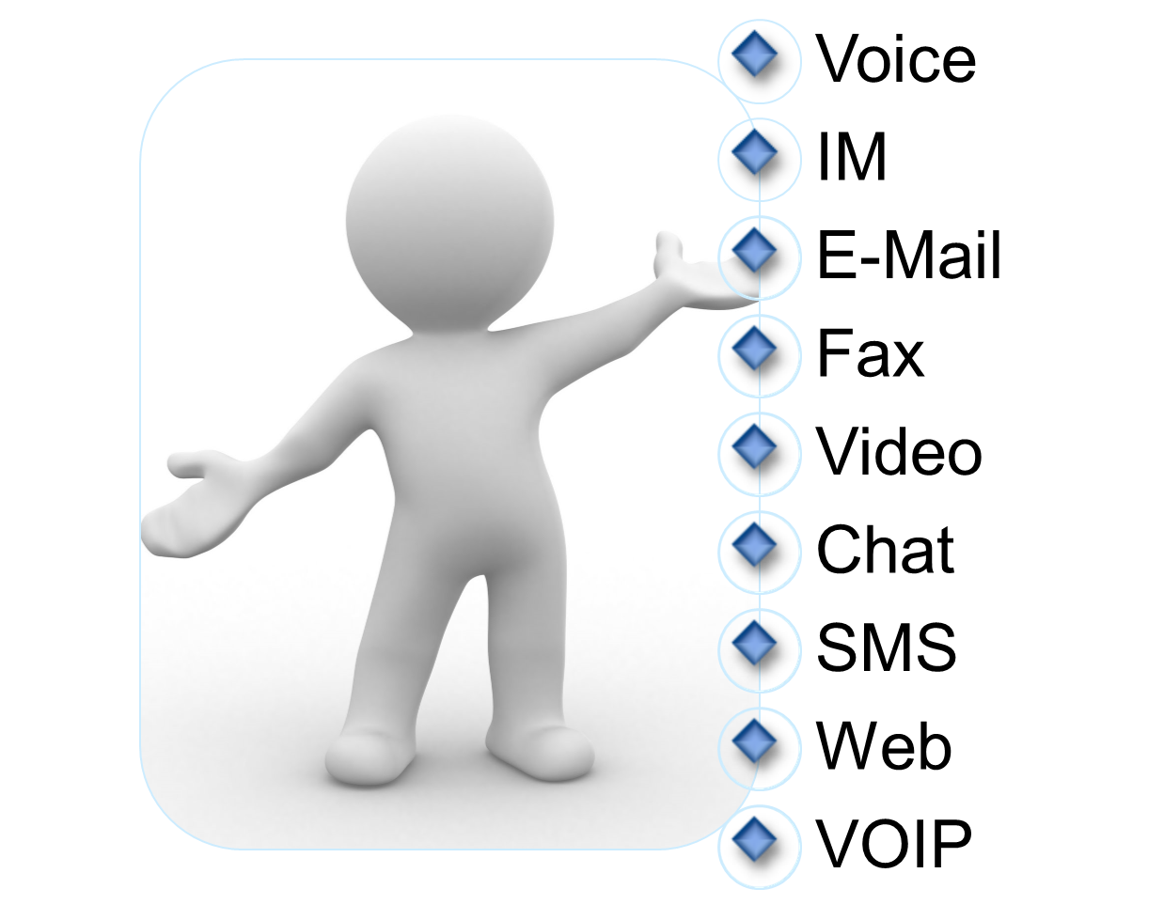
Multimodal
Communications

Slide 19
Multimodal Communications
Various people use various modes of communication.
Let us allocate the preferred mode of communication for the below Kenyan Age groups
15 - 25: Voice, IM, E-mail, Fax, Video, Chat, SMS, Web
26 - 35: Voice, IM, E-mail, Fax, Video, Chat, SMS, Web
36 - 46: Voice, IM, E-mail, Fax, Video, Chat, SMS, Web
46 - 60: Voice, IM, E-mail, Fax, Video, Chat, SMS, Web
60 +

Slide 20
Factors that led to the Rise of VoIP
The Communication world was changing to TCP/IP – The internet brought a revolution in the way people conducted business, communication etc.
Limitation of PBXs to transmit data. Convergence with data was not possible with PBXs.
Internet Protocol was necessary so as to support VoIP, conferencing and collaboration applications.
Lower costs. Convergence of voice, video and data through TCP/IP led to lower costs because it can ride on the same physical network as data = economies of scale.

Slide 21
VoIP & Convergence
VoIP is a popular choice for small, medium and large enterprises because VoIP rides on the same physical network as data. VoIP drives convergence. Convergence merges voice, video and data communications.
Convergence encompasses protocol, infrastructure and application convergence.

Slide 22
Protocol Convergence
TCP/IP has become the lowest common denominator for multimodal communications. Man applications have converged on the use of IP as the network layer protocol.

Slide 23
Infrastructure Convergence
Voice and data IP traffic goes over the same physical cabling. This is possible by using the same 4-pair, unshielded twisted-pair cabling.
For property developers this infrastructure convergence means that the same cable will be used for computers, VoIP phones, cable television, IP CCTV cameras etc and herald the Internet of Things.

Slide 24
The Internet of Things is Here
The Internet of Things (IoT) is increasing the connectedness of people and things on a scale that once was unimaginable. Connected devices outnumber the world's population by 1.5 to 1.
The pace of IoT market adoption is accelerating because of:
Growth in analytics and cloud computing
Increasing interconnectivity of machines and personal smart devices
The proliferation of applications connecting supply chains, partners, and customers

Slide 25
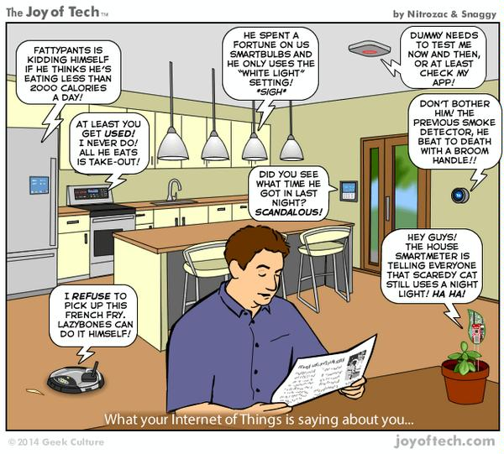

Slide 26
Application Convergence
Applications come together to improve productivity. Unified communications is an example. It integrates recorded voice messages into e-mail. That allows a user to play their voice messages remotely like an audio file sent b email.

Slide 27
Research on Multiplexing
(Time Division, Frequency etc)

Slide 28
End

